Slide 1


Christian Perez
08/30/2024

Slide 2

Outline
Executive Summary
Introduction
Methodology
Results
Conclusion
Appendix

Slide 3
Executive Summary
Summary of methodologies
Summary of all results

Slide 4
Introduction
Project background and context
Problems you want to find answers

Slide 5

Section 1

Slide 6
Methodology
Executive Summary
Data collection methodology:
Data was retrieved from SpaceX website using API and requesting data with Request library
Perform data wrangling
Using Pandas and Numpy libraries to analyze and identify data like numerical and categorical and perform changes like standardization of the data.
Perform exploratory data analysis (EDA) using visualization and SQL
Perform interactive visual analytics using Folium and Plotly Dash
Perform predictive analysis using classification models
It is needed to evaluate what alternatives of classification are in the dataset to fit what model will be uwed, convert categories, it is needed to calculate the distance of the points regarding to the predicted values. Evaluation of models apply to ensure the model will be accurate like Jaccard, F1 and Log loss.

Slide 7
Data Collection
Describe how data sets were collected. Data was retrieved from SpaceX website using API and requesting data with Request library
You need to present your data collection process use key phrases and flowcharts

Slide 8
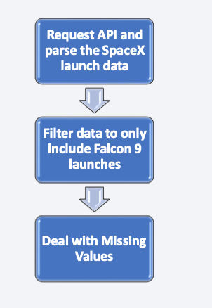
Data Collection – SpaceX API
SpaceX offers a public API from where data can be obtained and then used
https://github.com/ChristianPerezRamirez/IBMCapstone/blob/main/jupyter-labs-spacex-data-collection-api.ipynb
Place your flowchart of SpaceX API calls here

Slide 9
Data Collection - Scraping
SpaceX offers a public API from where data can be obtained and then used
https://github.com/ChristianPerezRamirez/IBMCapstone/blob/main/jupyter-labs-webscraping.ipynb

Slide 10
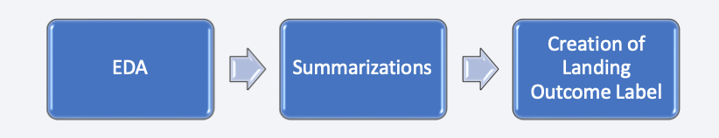
Data Wrangling
Exploratory Data Analysis was performed on the dataset.
Summary launches per site, occurrences of each orbit and occurrences of mission outcome per orbit type were calculated and the landing outcome label was created from Outcome column.

Slide 11
EDA with Data Visualization
Summarize what charts were plotted and why you used those charts
Top 5 launch sites whose name begins with the string 'CCA’;
Total pay load mass carried by boosters launched by NASA (CRS);
Average payload mass carried by booster version F9 v1.1;
Date when the first successful landing outcome in ground pad was achieved;
Names of the boosters which have success in drone ship and have payload mass between 4000 and 6000 kg;
Total number of successful and failure mission outcomes;
Names of the booster versions which have carried the maximum payload mass;
Failed landing out comes in droneship, their booster versions, and launch site names for in year 2015; and
Rank of the count of landing outcomes (such as Failure (droneship) or Success (ground pad)) between the date 2010-06-04 and 2017-03-20.
https://github.com/ChristianPerezRamirez/IBMCapstone/blob/main/edadataviz.ipynb

Slide 12
EDA with SQL
Scatterplots and bar plots were used to visualize the relationship between pair of features:
Payload Mass X Flight Number, Launch Site X Flight Number, Launch Site X Payload Mass, Orbit and Flight Number, Payload and Orbit
https://github.com/ChristianPerezRamirez/IBMCapstone/blob/main/jupyter-labs-eda-sql-coursera_sqllite.ipynb

Slide 13
Build an Interactive Map with Folium
Markers, circles, lines and marker clusters were used with Folium Maps
Markers indicate points like launch sites;
Circles indicate highlighted areas around specific coordinates, like NASA Johnson Space Center;
Marker clusters indicates groups of events in each coordinate, like launches in a launch site; and
Lines are used to indicate distances between two coordinates.
https://github.com/ChristianPerezRamirez/IBMCapstone/blob/main/lab_jupyter_launch_site_location.ipynb

Slide 14
Build a Dashboard with Plotly Dash
Interactive dashboard with Plotly dash
Pie charts showing the total launches by a certain sites
Scatter graph showing the relationship with Outcome and Payload Mass (Kg) for the different booster version.
https://github.com/ChristianPerezRamirez/IBMCapstone/tree/main

Slide 15
Predictive Analysis (Classification)
Data using numpy and pandas, transformed the data, split our data into training and testing.
Different machine learning models and tune different hyperparameters using GridSearchCV.
Accuracy as the metric for our model, improved the model using feature engineering and algorithm tuning.
Best performing classification model.
https://github.com/ChristianPerezRamirez/IBMCapstone/blob/main/Machine%20Learning%20Prediction.ipynb

Slide 16
Results
Space X uses 4 different launch sites;
First launches were done to Space X itself and NASA;
Average payload of F9 v1.1 booster is 2,928 kg;
First success landing outcome happened in 2015 fiver year after the first launch;
Falcon 9 booster versions were successful at landing in drone ships having payload above the average;
100% of mission outcomes were successful;
Two booster versions failed at landing in drone ships in 2015: F9 v1.1 B1012 and F9 v1.1 B1015;
The number of landing outcomes became as better through the years.

Slide 17
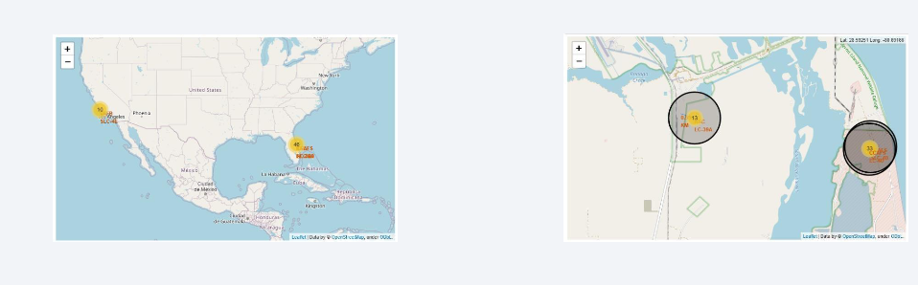
Results

Slide 18

Section 2

Slide 19

Flight Number vs. Launch Site
The larger the flight amount at a launch site, the greater the success rate at a launch site.

Slide 20
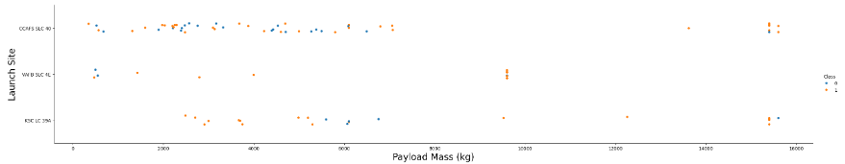
Payload vs. Launch Site

Slide 21
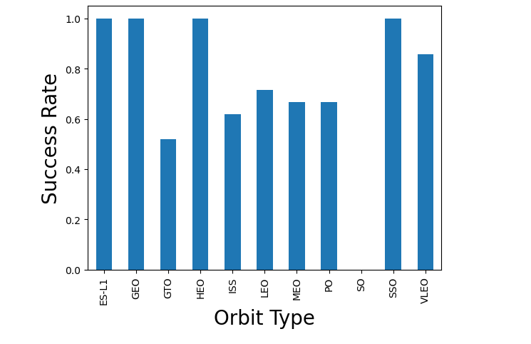
Success Rate vs. Orbit Type
ES-L1, GEO, HEO, SSO, VLEO had the most success rate.

Slide 22
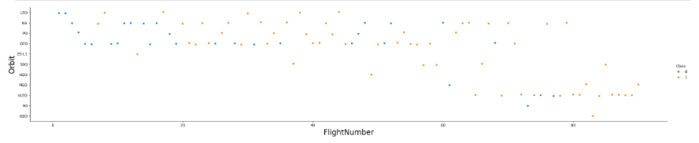
Flight Number vs. Orbit Type
LEO orbit, success is related to the number of flights whereas in the GTO orbit, there is no relationship between flight number and the orbit. Show the screenshot of the scatter plot with explanations

Slide 23
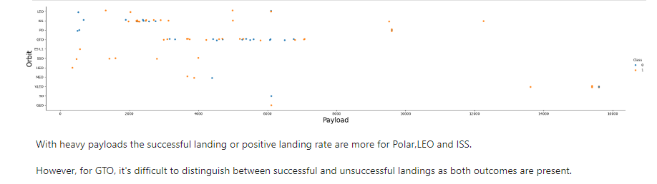
Payload vs. Orbit Type

Slide 24
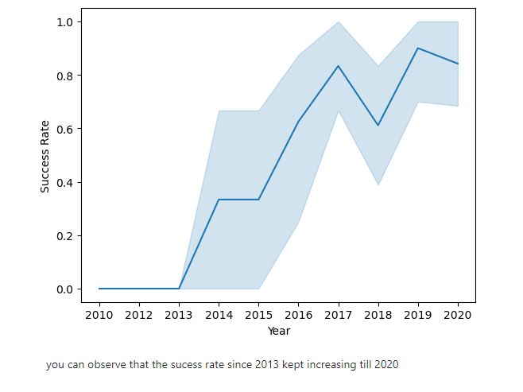
Launch Success Yearly Trend

Slide 25
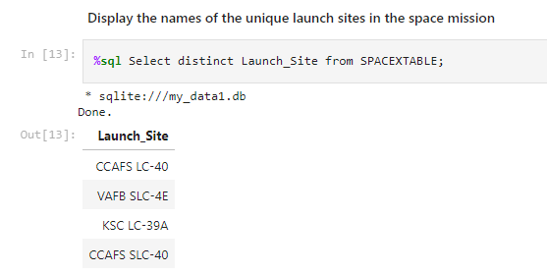
All Launch Site Names

Slide 26
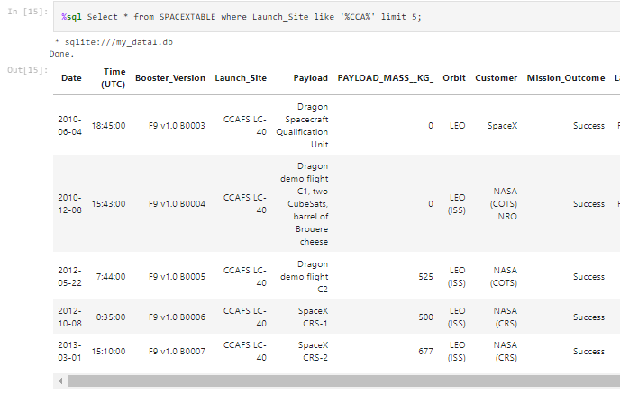
Launch Site Names Begin with 'CCA'

Slide 27
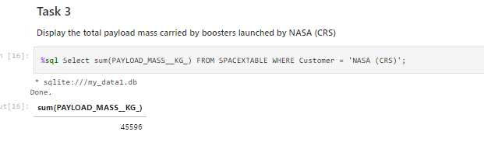
Total Payload Mass

Slide 28
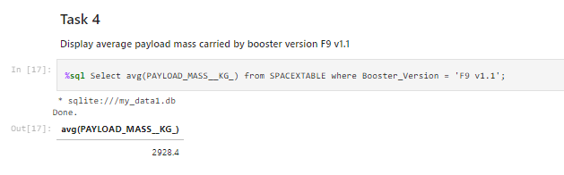
Average Payload Mass by F9 v1.1

Slide 29
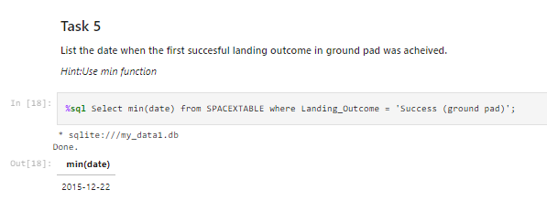
First Successful Ground Landing Date

Slide 30
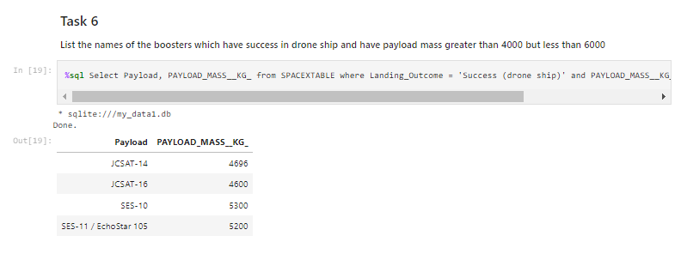
Successful Drone Ship Landing with Payload between 4000 and 6000

Slide 31
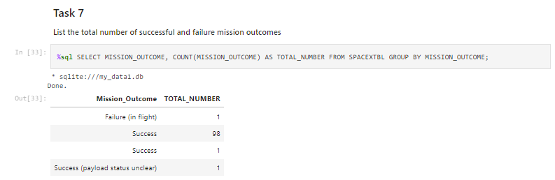
Total Number of Successful and Failure Mission Outcomes

Slide 32
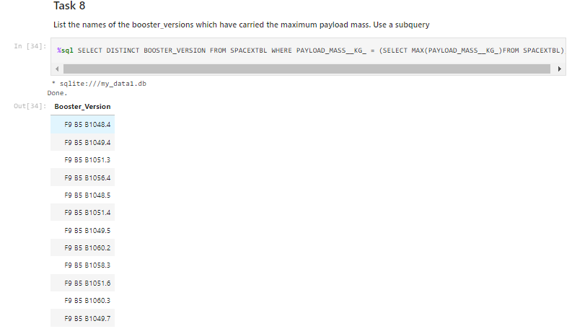
Boosters Carried Maximum Payload

Slide 33
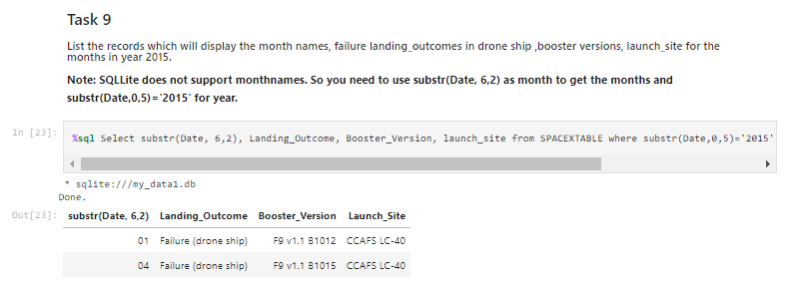
2015 Launch Records

Slide 34
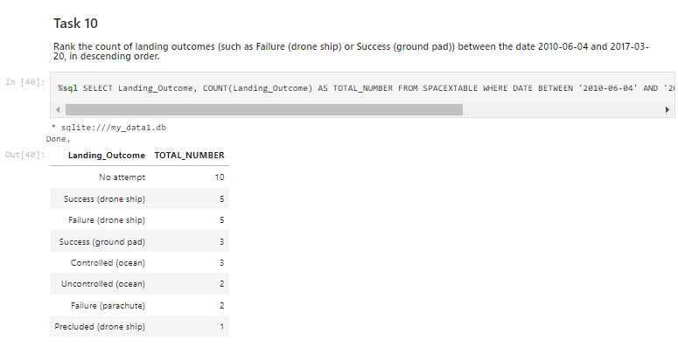
Rank Landing Outcomes Between 2010-06-04 and 2017-03-20

Slide 35

Section 3

Slide 36

<Folium Map Screenshot 1>

Slide 37

<Folium Map Screenshot 2>

Slide 38

<Folium Map Screenshot 3>

Slide 39

Section 4

Slide 40

Pie Chart achievements by launch site
Replace <Dashboard screenshot 1> title with an appropriate title
Show the screenshot of launch success count for all sites, in a piechart
Explain the important elements and findings on the screenshot

Slide 41

Highest Launch Succes Ratio Pie Chart

Slide 42

Payload / Launch Outcome

Slide 43

Section 5

Slide 44

Classification Accuracy
The decision tree classifier is the model with the highest classification accuracy

Slide 45

Confusion Matrix
The confusion matrix for the decision tree classifier shows that the classifier can distinguish between the different classes. The major problem is the false positives .i.e., unsuccessful landing marked as successful landing by the classifier.

Slide 46
Conclusions
The larger quantity of flights at a launch site, the greater the success rate at a launch site.
Launch success rate started to increase in 2013 till 2020.
Orbits ES-L1, GEO, HEO, SSO, VLEO had the most success rate.
KSC LC-39A had the most successful launches of any sites.
The Decision tree classifier is the best machine learning algorithm for this task.

Slide 47
Appendix
Include any relevant assets like Python code snippets, SQL queries, charts, Notebook outputs, or data sets that you may have created during this project

Slide 48


